Slide 1


Data Analysis of Historical Stock Data
TEAM#4
Fadi Tabet
Vandana Iyer
Omkar Daphal

Slide 2

PROJECT GOAL
Project goal is to build a resilient and high efficient Scala/Spark application that is able to parse & analyze big records of financial stock data to provide meaningful and accurate analysis result and prediction.

Slide 3
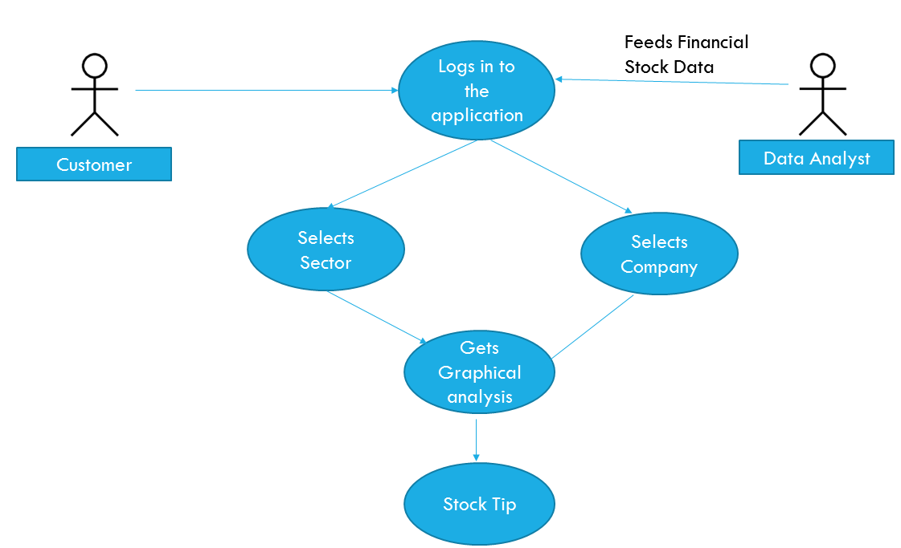
GENERAL USE CASE

Slide 4

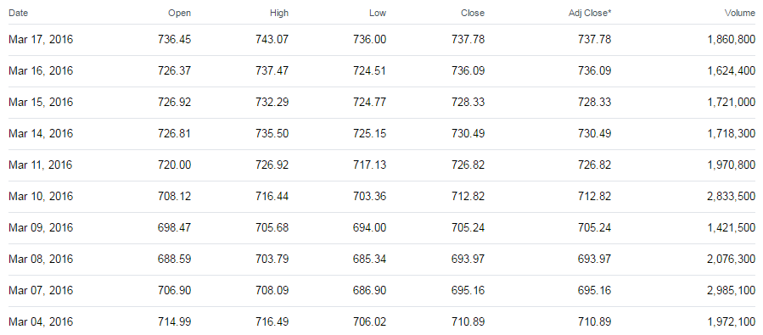
THE DATA SOURCE (~70,000 rows)
10 years of stock data (open, high, low, close and volume) for 5 companies in 5 different sectors received from Yahoo Financial API.
http://download.finance.yahoo.com/d/quotes.csv?s=%40%5EDJI,GOOG&f=nsl1op&e=.csv

Slide 5

PROJECT DESIGN
Part 1: Visualization of Performance Comparison
Data source
Meta data
Data from Yahoo Finance
Data containing Index and Sector Information
Match
FilteredData.csv
Perform Stock Gain Calculation to enhance information
Load Data to DB
Visualization using jQuery Library

Slide 6
PROJECT DESIGN
Part 2: -
Data Prediction Using MLLib
Choose Target -> If stock will close at price > Open & Close Price
Adding more information -> Previous Close
Splitting Files (Training 60%,Validation 20%,Test 20%)
Feature Selection (Open, High, Low, Close, Prev Close)
Optimal Parameters Selection
Compare prediction models(Decision Tree, Random Forest, Naïve Bayes, Linear Regression)
Adopted Decision Tree for Classification & Linear Regression for close price prediction

Slide 7

CODE WALKTHROUGH
timeElapsed(): It is a custom method definition that encapsulates the code execution and calculates time taken to execute the piece of code.
DataAnalysis: Scala class that handles preparation of source file with added information and loads to DB
ClassifyClose : Scala Class that performs MLLIB Decision Tree algorithm to predict if stock will close above Open price.
PredictClose : Scala Class that performs Linear regression to predict close price of a stock on a given day.

Slide 8
TEST CASES
Source file should not be null/empty.
Source file should be successfully loaded to dataframe.
Time should be returned in String.
Enhanced Source file with additional data should be deleted (if existing) before creating a new copy.
Optimal Parameters to be used for prediction model should not be null.

Slide 9
Loading & Cleaning
Used csv to load the data
Added the columns that were essential
Drastically widened the scope
Close greater than open | Open | High | Low | Close | PrevClose
1 | 22.02 | 22.26 | 21.95 | 22.1 | 22
0 | 22.33 | 22.39 | 21.77 | 22 | 22.33
0 | 22.62 | 22.67 | 22.26 | 22.33 | 22.61
0 | 22.71 | 22.74 | 22.54 | 22.61 | 22.6
1 | 22.51 | 22.65 | 22.43 | 22.6 | 22.54
0 | 22.6 | 22.73 | 22.47 | 22.54 | 22.63
0 | 22.72 | 22.72 | 22.47 | 22.63 | 22.71
1 | 22.63 | 22.83 | 22.61 | 22.71 | 22.48
0 | 22.6 | 22.72 | 22.33 | 22.48 | 22.66
Close | Open | High | Low | Previous Close
102.95 | 104.07 | 104.22 | 102.47 | 103.68
103.68 | 103.63 | 104.39 | 103.41 | 103.769997
103.77 | 104.83 | 105.16 | 103.5 | 104.980003
104.98 | 105 | 105.9 | 104.86 | 105.019997
105.02 | 104.61 | 105.42 | 104.61 | 104.720001
104.72 | 105.12 | 105.15 | 103.95 | 105.510002
105.51 | 105.74 | 106.06 | 104.48 | 105.769997
105.77 | 105.5 | 105.88 | 104.76 | 105.290001
105.29 | 103.57 | 106.08 | 103.41 | 103.550003

Slide 10

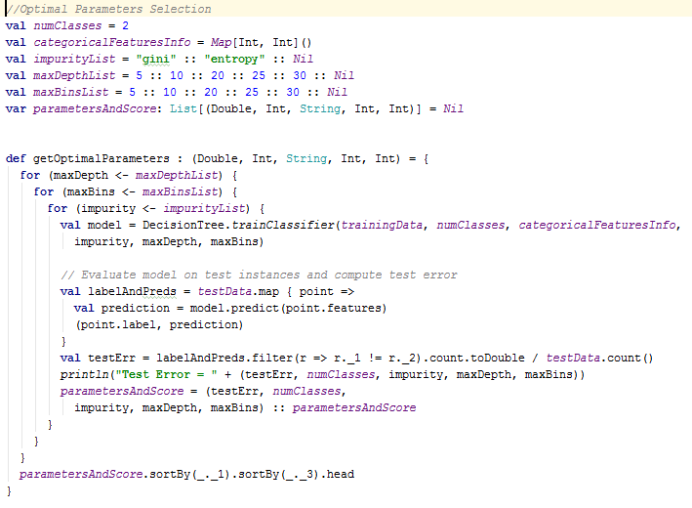
TRAIN ALGORITHM
Iterated over a set of values for different parameters to select the best possible set.

Slide 11

Demo

Slide 12

Results:
Achieved an accuracy of 52% for predicting if a stock will close at a price greater than open price.
Achieved excellent analysis on existing data.
Achieved Root Mean Square Value of ~ 3.5 which means the predicted value deviates by as little as 3.5
Achieved efficient visualization in terms of performance of stocks in different sectors.

Slide 13
Said Vs Achieved
Deliverable is ~ error free. Yes
Meets all requirements in “Requirements gathering & analysis steps”. Yes
Project is documented. Yes
Scalability and Extensibility over different data sets (performance with data for 20 years x 20 companies x 20 sectors => ~2M+ Rows). Yes

Slide 14

Thank
you

